Slide 1
Rental Housing Safety Program Year-End Report 2022
March , 2023

Slide 2
Overview
Property Map
Registered Properties at a Glance
Year-end Registration – 2022
Inspection/Re-Inspection By Property Type
Common Inspection Items Failed
RHSP Property Inspections & Improvements
Mandated Inspections and Outcomes
5 Years In Review

Slide 3
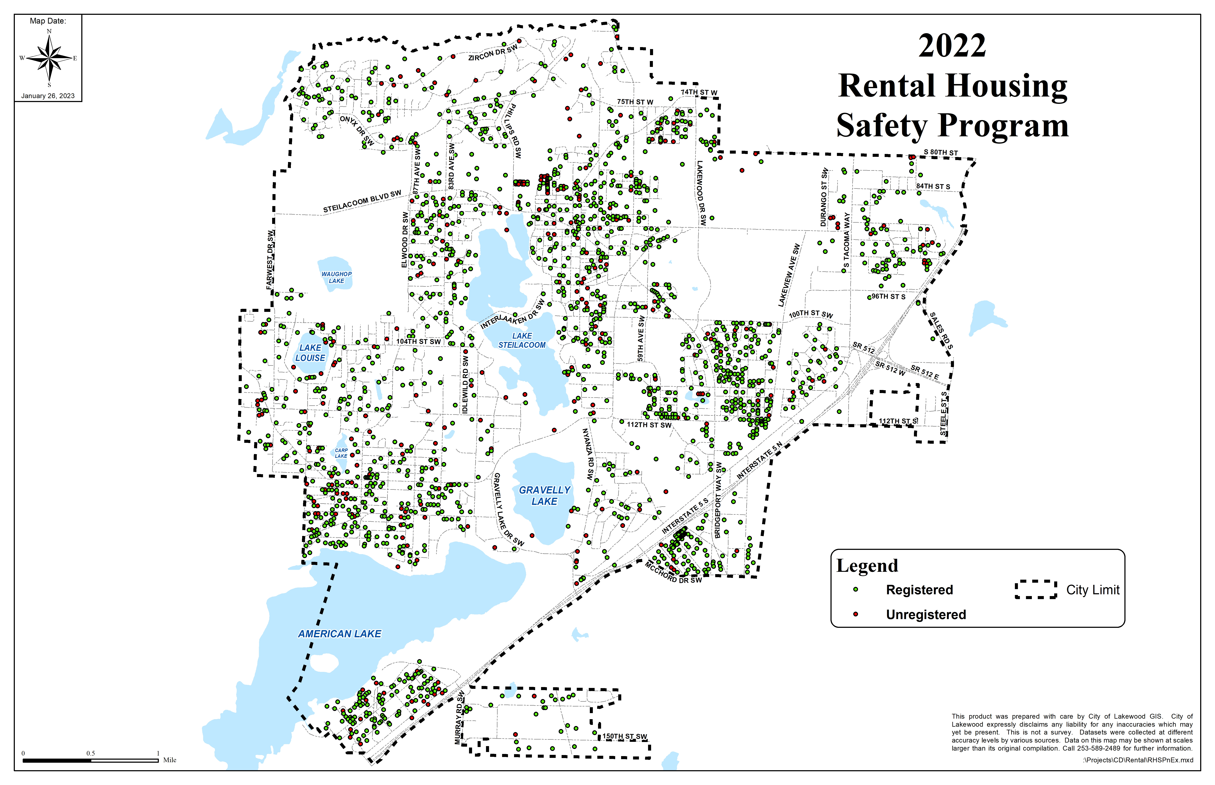
Need new!!!

Slide 4
Year-end Registration - 2022
MF 31; SF/Duplex 311
MF 372; SF/Duplex 311
MF 326; SF/Duplex 1,528
MF 9,662; SF/Duplex 1,975
Year-end Registration - 2021
Properties
Unregistered: 585 (24%)
Registered: 1,818 (76%)
Units
Unregistered: 712 (6%)
Registered: 10,923 (94%)

Slide 5
Registered Properties at a Glance - 2022
1,854 Properties Registered
Largest Property: 520 units

Slide 6
2022 Initial Inspections by Property Type

Slide 7
Initial Inspection Results - 2022
MF 1; SF 7; Duplex 0
MF 1; SF 7; Duplex 0
8 Passed (4%)
173 Failed (96%)
MF 38; SF 39; Duplex 12
MF 113; SF 39; Duplex 21
Comparison: 2021 Failed – 87% 2021 Failed – 91%

Slide 8
2022 Re-Inspections by Property Type

Slide 9
Re-Inspection Results - 2022
MF 13; SF 18; Duplex 6
MF 142; SF 18; Duplex 11
171 Failed (40%)
252 Passed (60%)
125 Passed (77%)
MF 145; SF 70; Duplex 38
MF 27; SF 75; Duplex 23
Comparison: 2021 Passed – 75% 2021 Passed – 47%

Slide 10
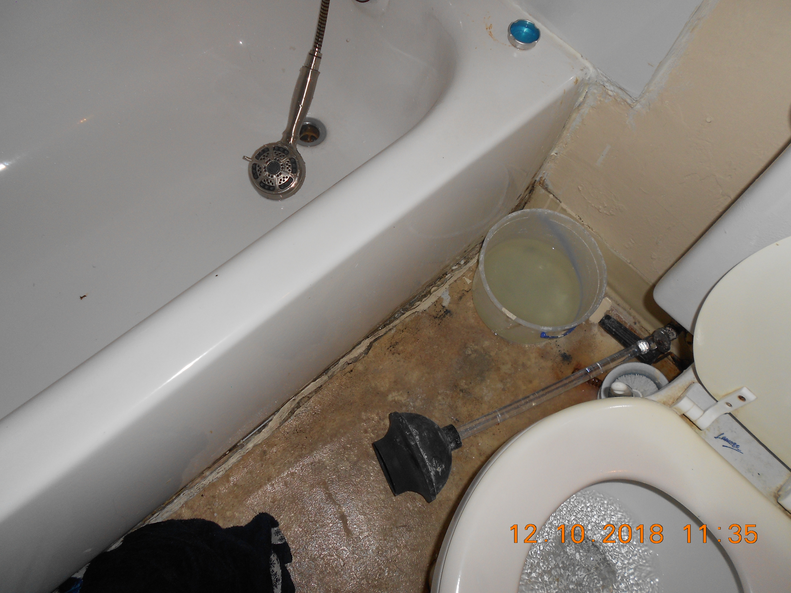
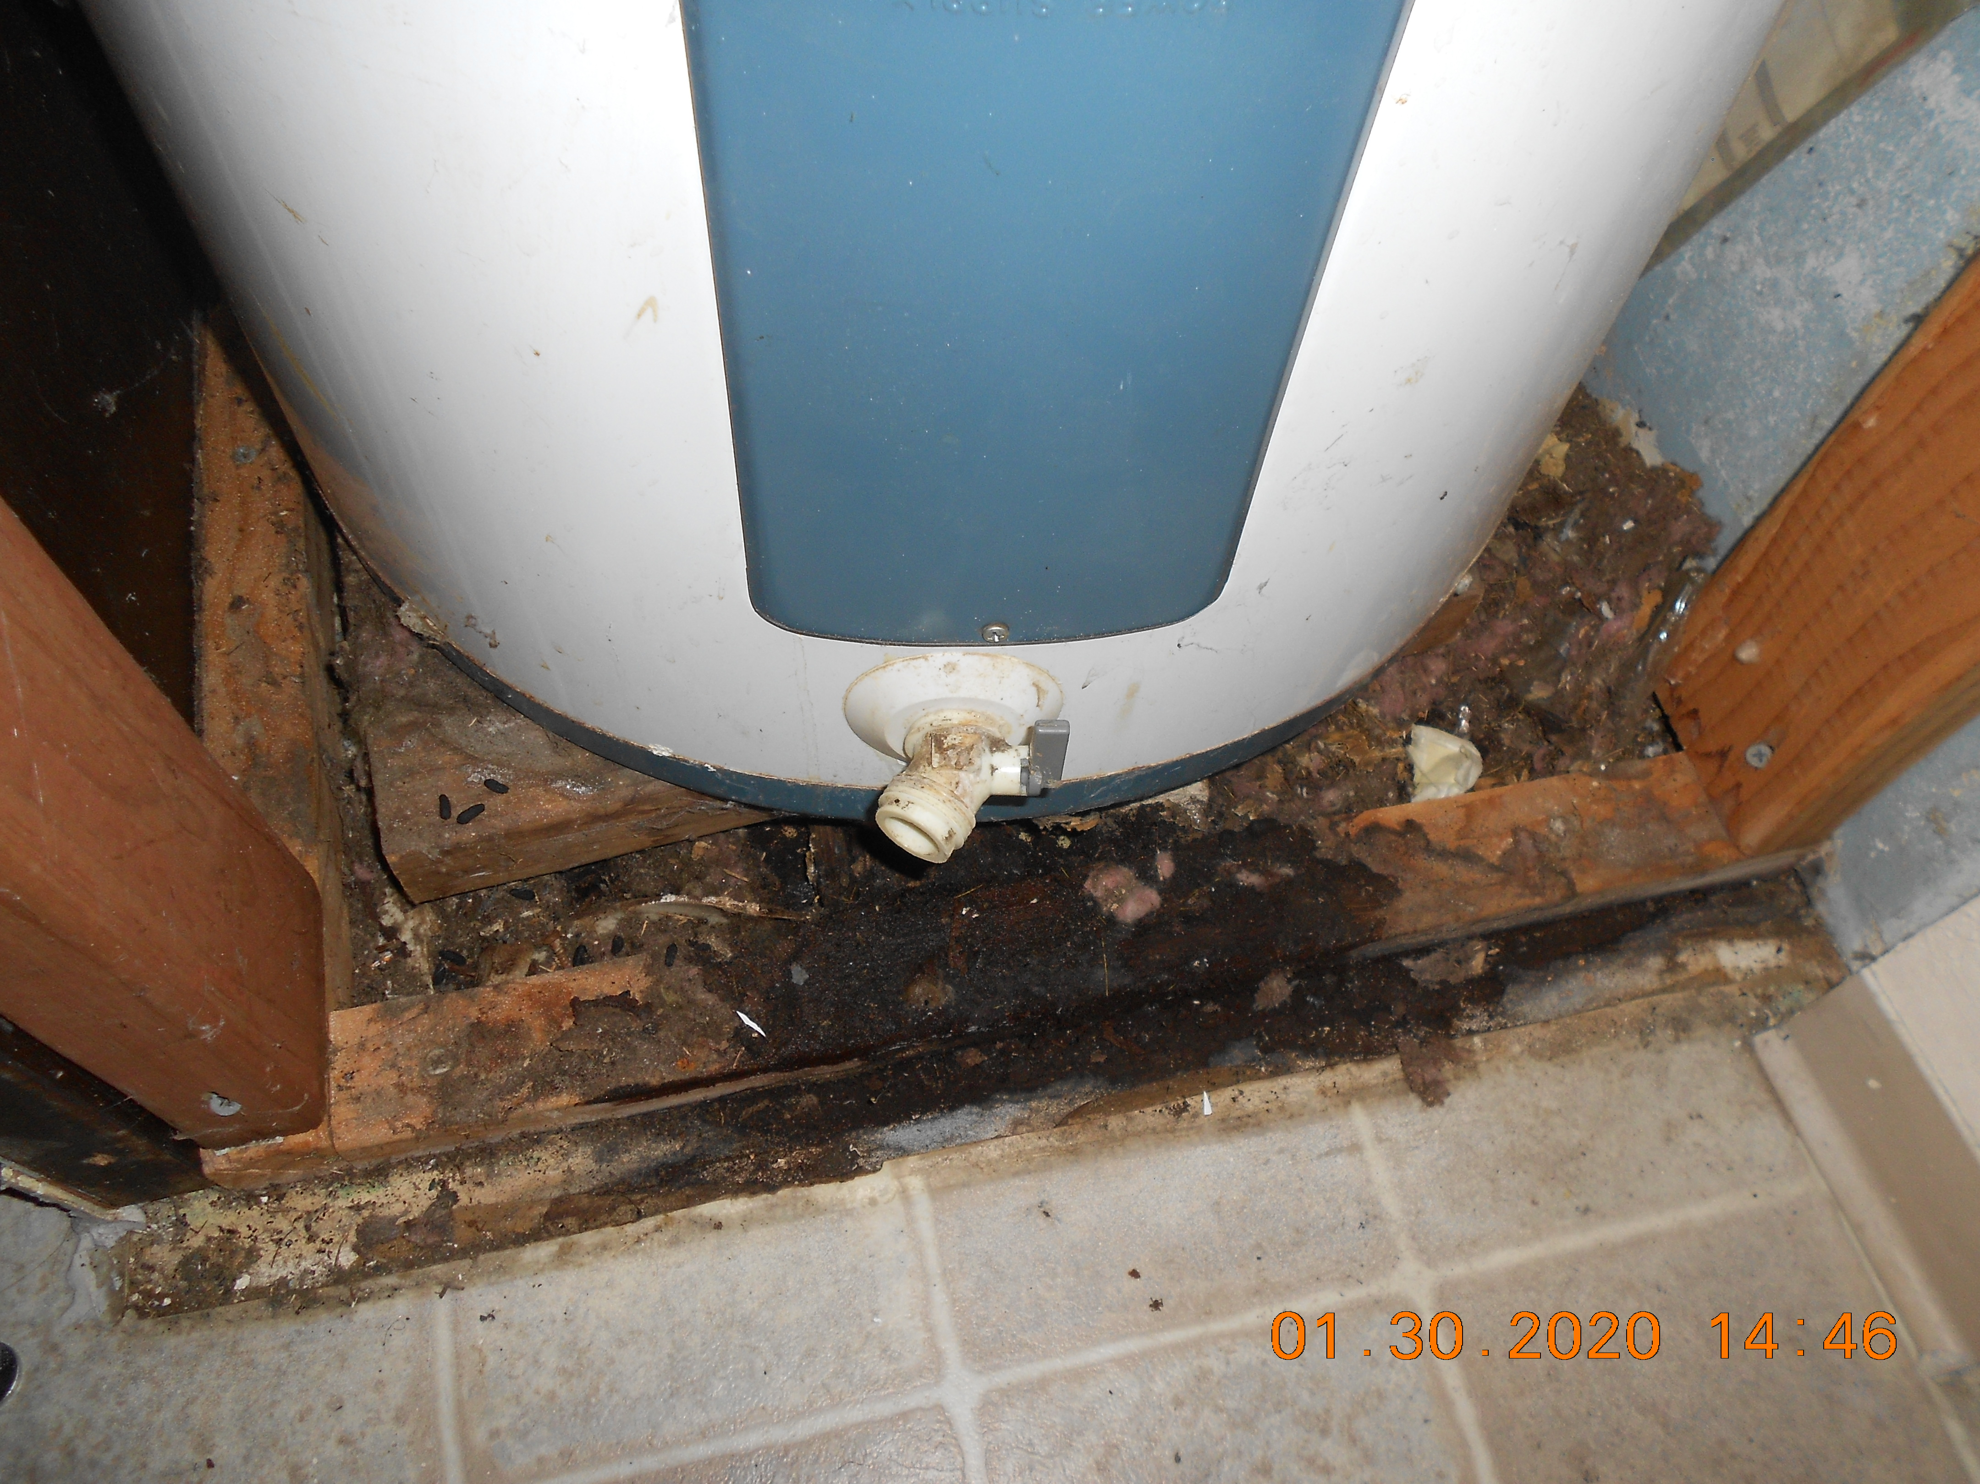
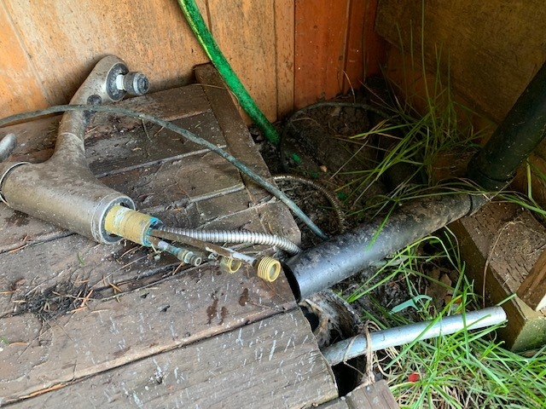
Common Inspection Items Failed
Comparison:
2021 Common Items Failed - 1) Smoke & CO Detectors; 2) Water Heaters; 3) Electrical and 4) Plumbing

Slide 11
Inspection Insights – 2022
Initial Inspection Results – By Property
Re-Inspection Results – By Property

Slide 12
Mandated Inspection Outcomes for 2021
3
3
3
8
1
1
1

Slide 13
Mandated Inspection Outcomes for 2022
2
1
3
8
17
3
3
8
1
1

Slide 14
Challenges Experienced –2022
Working with remaining properties to complete re-inspection of units which failed between 2019 and 2022.
Enforcement of unregistered properties.
Mandating Inspections for unregistered and noncompliant properties.

Slide 15
Five Years In Review
Registered Properties and Units Per Year
Inspected Properties and Units Per Year
Inspected Properties and Units Passed & Failed Per Year

Slide 16
Registered Properties and Units By Year

Slide 17
Inspected Properties and Units By Year

Slide 18
Passed and Failed Properties and Units by Year

Slide 19
QUESTIONS?

